Slide 1
Streaming Potential And Streaming Current of a Particle Covered Surface
Part 1
Krzysztof Sadlej
ZMiFP IPPT PAN

Slide 2
Overview
Introduction
Electrical Double Layer (EDL)
Gouy-Chapman-Stern model
Electrokinetics
  Electro-osmosis
  Electrophoresis
  Streaming current/Streaming potential
Measuring the Streaming Potential
Particles adsorbed at the interface – what changes?

Slide 3
Inspirers, Co-Workers
Prof.. Zbigniew Adamczyk (IKiFP PAN)
Wligiusz Wajnryb (IPPT PAN)
Maria Ekiel-Jeżewska (IPPT PAN)
Jerzy Bławzdziewicz (Yale University)

Slide 4
Introduction
Charge…
Surface charge [C m⁻² ] | a=10⁻⁶ m |  | a=10⁻⁴ m
 | ψ[V] | E[V m⁻¹] | ψ[V] | E[V m⁻¹]
0.16 | 1.8 x 10⁴ | 1.8 x 10¹⁰ | 1.8 x 10⁶ | 1.8 x 10¹⁰
 | 2.31 x 10² | 2.31 x 10⁸ | 2.31 x 10⁴ | 2.31 x 10⁸
1.6 x10⁻³ | 1.8 x 10² | 1.8 x 10⁸ | 1.8 x 10⁴ | 1.8 x 10⁸
 | 2.31 | 2.31 x 10⁶ | 2.31 x 10² | 2.31 x 10⁶

Slide 5
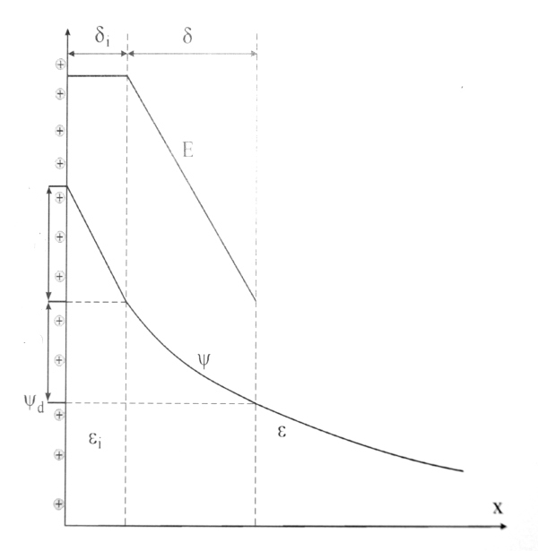




Electrical Double Layer (EDL)
Stern layer
Diffuse layer
Zeta-potential

Slide 6
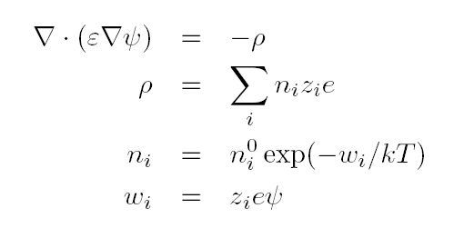
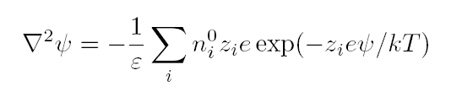
Gouy-Chapman-Stern model
Bulk concentration of ions
Concentration of ions
Poisson-Boltzmann equation:

Slide 7

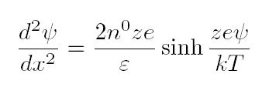
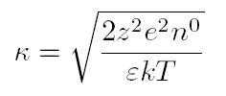
Gouy-Chapman-Stern model
Solution method od the Poisson-Boltzmann eq.
  Debye-Hückel approx. Works only for
  Gouy-Chapman model:
    Flat surface
    Symmetric electrolite z_{i} = z₊ = z₋ = z
Debye-Hückel parameter

Slide 8
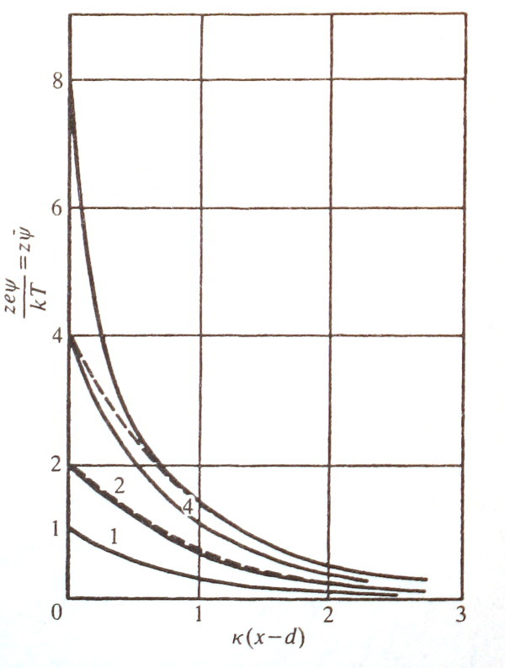




Gouy-Chapman-Stern model

Slide 9
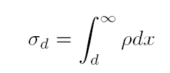




Gouy-Chapman-Stern model
Diffuse layer charge
Adsorbed charge in the inner region (Stern layer, Stern 1924, Graham 1947)
  No charge within the layer of thickness δ_{i}

Slide 10


Gouy-Chapman-Stern model
What is the charge distribution in the layer δ?
  Uniform space charge distribution, distant-dependent permittivity
  Or
  All ions are assumed to be confined to a layer and are treated as point charges.

Slide 11
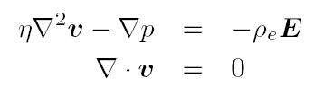


Electro-Osmosis
Motion of liquid induced by an applied electric field
Stokes equations
Slip velocity
Smoluchowski 1903

Slide 12


Electrophoresis
Motion of suspended particles in an applied electric field
Electrophoretic mobility
Smoluchowski 1921

Slide 13
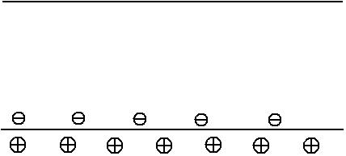
Streaming current and Streaming Potential
Current appearing due to double-layer charge movement with the fluid
Transfer of charge downstream (due to pressure gradient) is balanced by current due to electric field
Potential drop associated with this field: STREAMING POTENTIAL

Slide 14
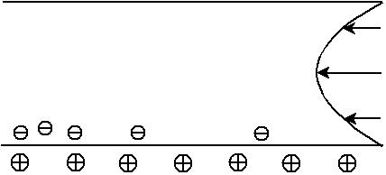
Streaming current and Streaming Potential
Current appearing due to double-layer charge movement with the fluid
Transfer of charge downstream (due to pressure gradient) is balanced by current due to electric field
Potential drop associated with this field: STREAMING POTENTIAL

Slide 15
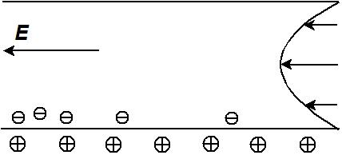
Streaming current and Streaming Potential
Current appearing due to double-layer charge movement with the fluid
Transfer of charge downstream (due to pressure gradient) is balanced by current due to electric field
Potential drop associated with this field: STREAMING POTENTIAL

Slide 16

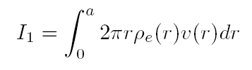



Streaming current and Streaming Potential
Pressure difference
Poiseuille flow in a tube:
Tube length
Electric current due to convection:
Dominant contribution from the double layer:

Slide 17

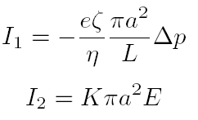
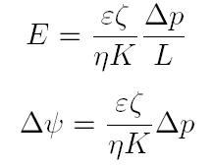
Streaming current and Streaming Potential
Balance of currents:
Streaming potential
Electrolite conductivity

Slide 18
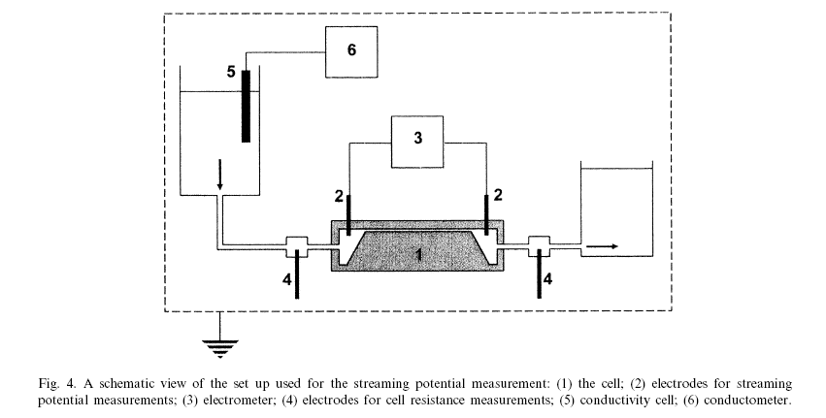
Measuring the Streaming Potential
M. Zembala et al. Colloids and Surfaces A 195 (2001), 3-15

Slide 19
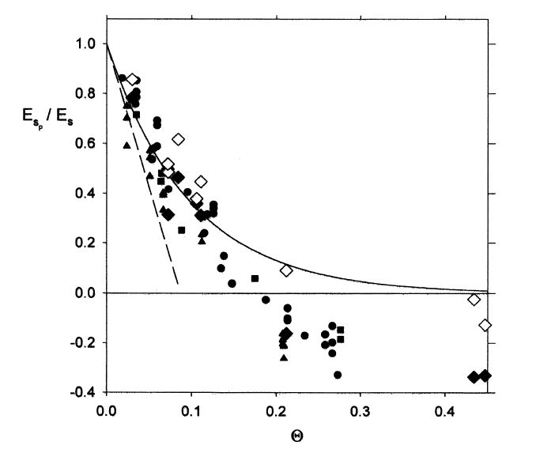
Particles adsorbed at the interface – what changes?
Rapid decrease of the streaming current/potential with particle concentration θ

Slide 20
To be continued…
Can this dependence be explained theoretically??
  Hydrodynamics
  Statistical Physics
Virial expansion, Simulations

